Slide 1


Data Science Project
Dataset: Air traffic landing statistics on San Francisco Airport Goal or Project: To identify task that generates some meaningful insight from the given data.
Rohit kumar suman Saurav
Vishal Sharma Dashrath Paswan
Monu Kumar shivansh Srivastava

Slide 2
Sub–Divisions of Project
Step 1 | Step 2 | Step 3 | Step 4 | Step 5
Data Preprocessing and Data Cleaning | Data Visualization | Data Statics or Summary of Data | Hypothesis Testing | ML Prediction
Data Cleaning is the process in which if the data have many irrelevant and missing parts. To handle this part, data cleaning is done. It involves handling of missing data, noisy data etc. | Data visualization is the visual presentation of data or information. The goal of data visualization is to communicate data or information clearly and effectively to readers. Typically, data is visualized in the form of a chart, infographic, diagram or map. | Statistics is a set of mathematical methods and tools that enable us to answer important questions about data. It is divided into two categories: Descriptive Statistics Inferential Statistics | Hypothesis testing is a set of formal procedures used by statisticians to either accept or reject statistical hypotheses. | Linear regression is a linear approach for modelling the relationship between a scalar response and one or more explanatory variables.

Slide 3
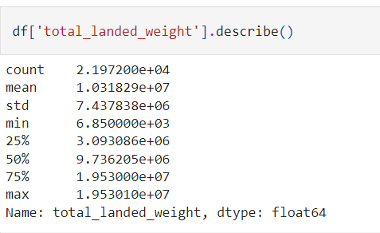
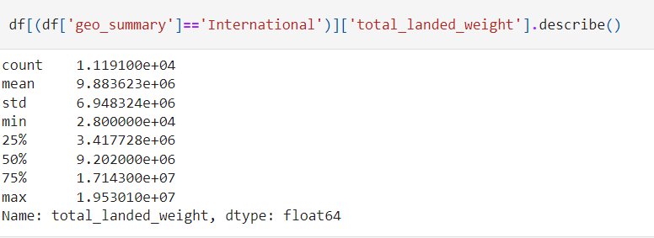
STEP 3: Data Statics or Summary of Data

Slide 4
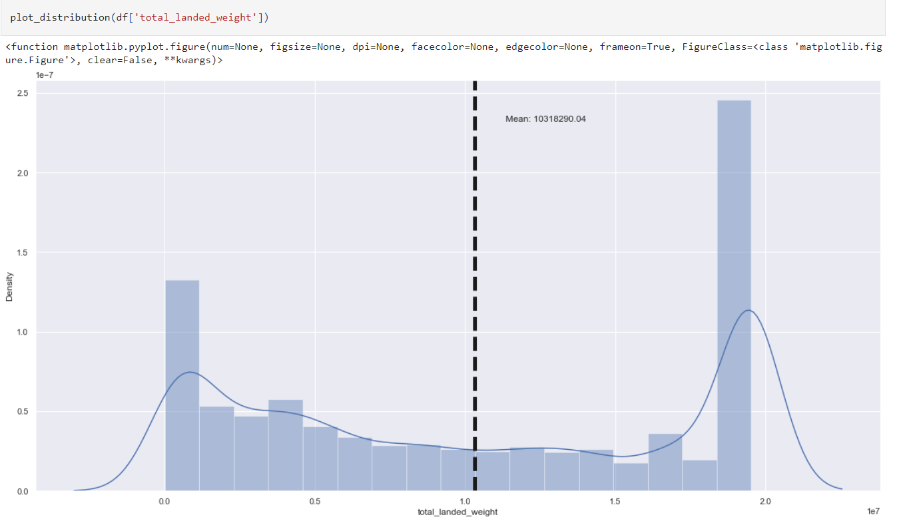

Slide 5
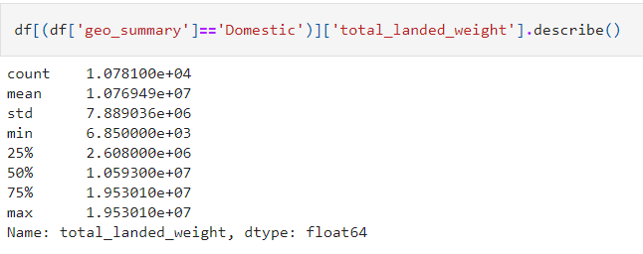

Slide 6
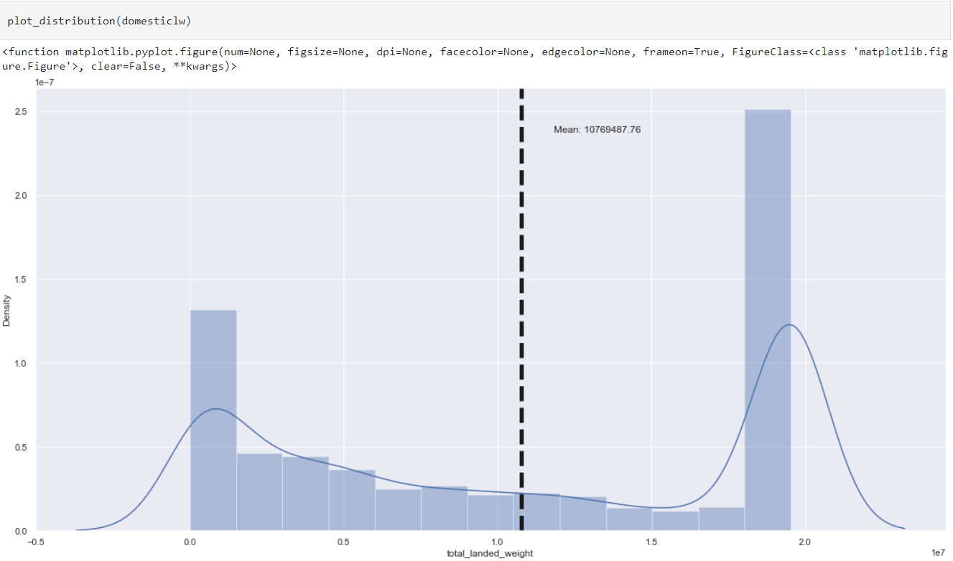

Slide 7
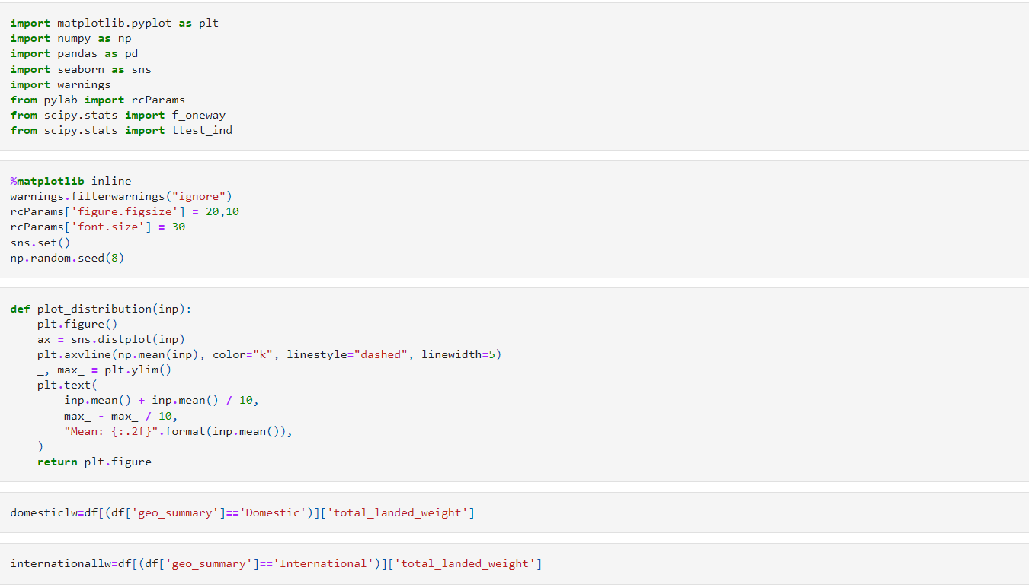
STEP 4:Hypothesis Testing
Importing library for hypothesis testing and defining some important function for distribution curve

Slide 8
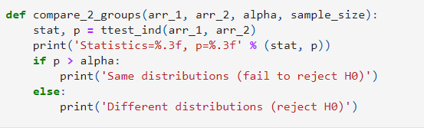
Defining function for hypothesis testing

Slide 9

Our first hypothesis testing using t test
We have checked the landing weight of all flights that landed at the San Francisco airport and we also checked the landing weight of all domestic flights. now we are applying our code for checking whether the distribution curve of these two curves is the same or not.

Slide 10


Slide 11
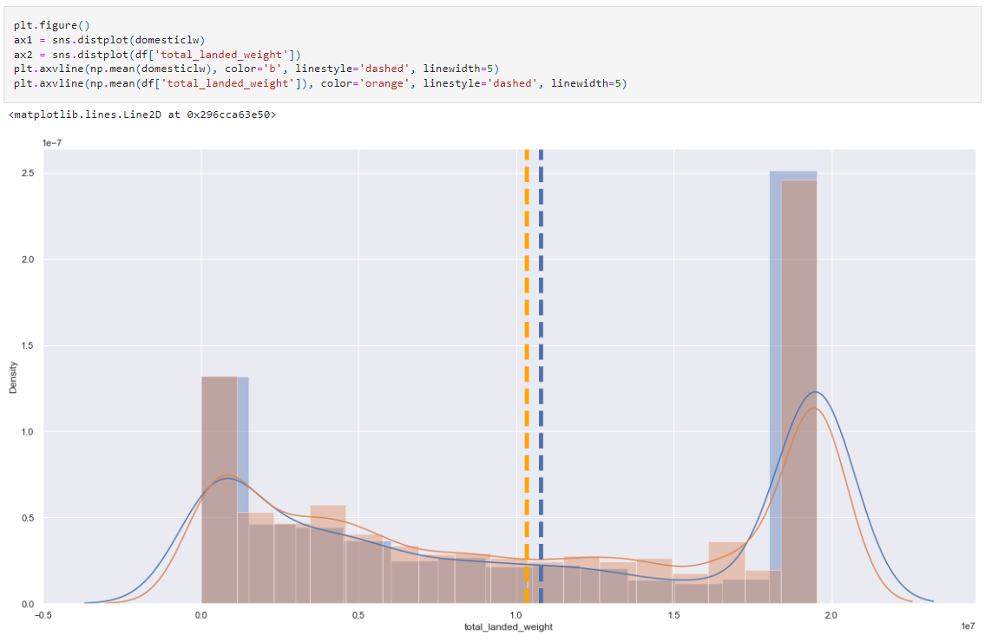

Slide 12
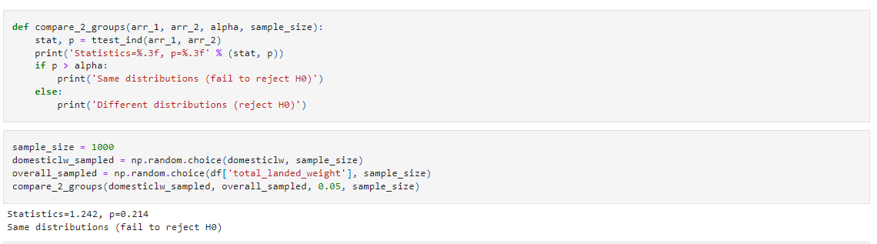
From the below code we conclude that both distribution are same

Slide 13
Our second hypothesis testing by using t test
We have checked the landing count US flights at the San Francisco airport and we also checked the landing count of all Asian flights. now we are applying our code for checking whether the distribution curve of these two curves is the same or not.

Slide 14
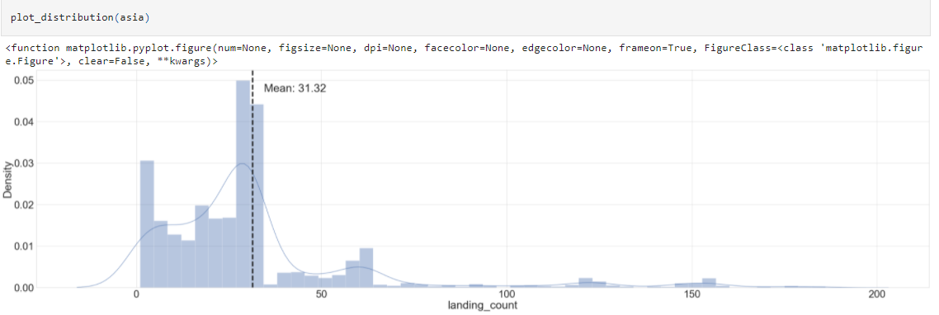

Slide 15
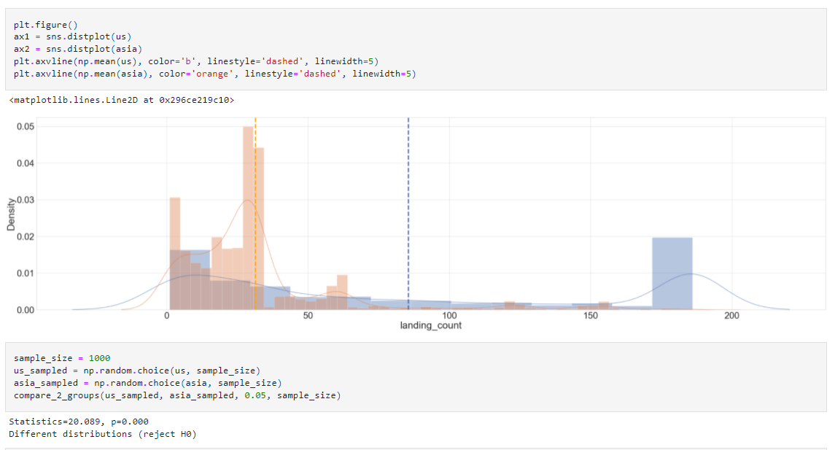
From the below code we conclude that both distribution are different

